Slide 1
New Trends and Applications
in Computer Vision
Group 3

Slide 2
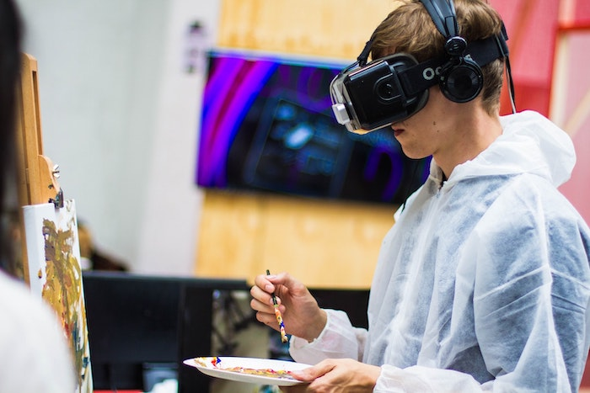
Augmented Reality with Computer Vision
Computer Vision plays an important role in augmented reality by enabling computers to understand visual information and overlay it with digital information.

Slide 3
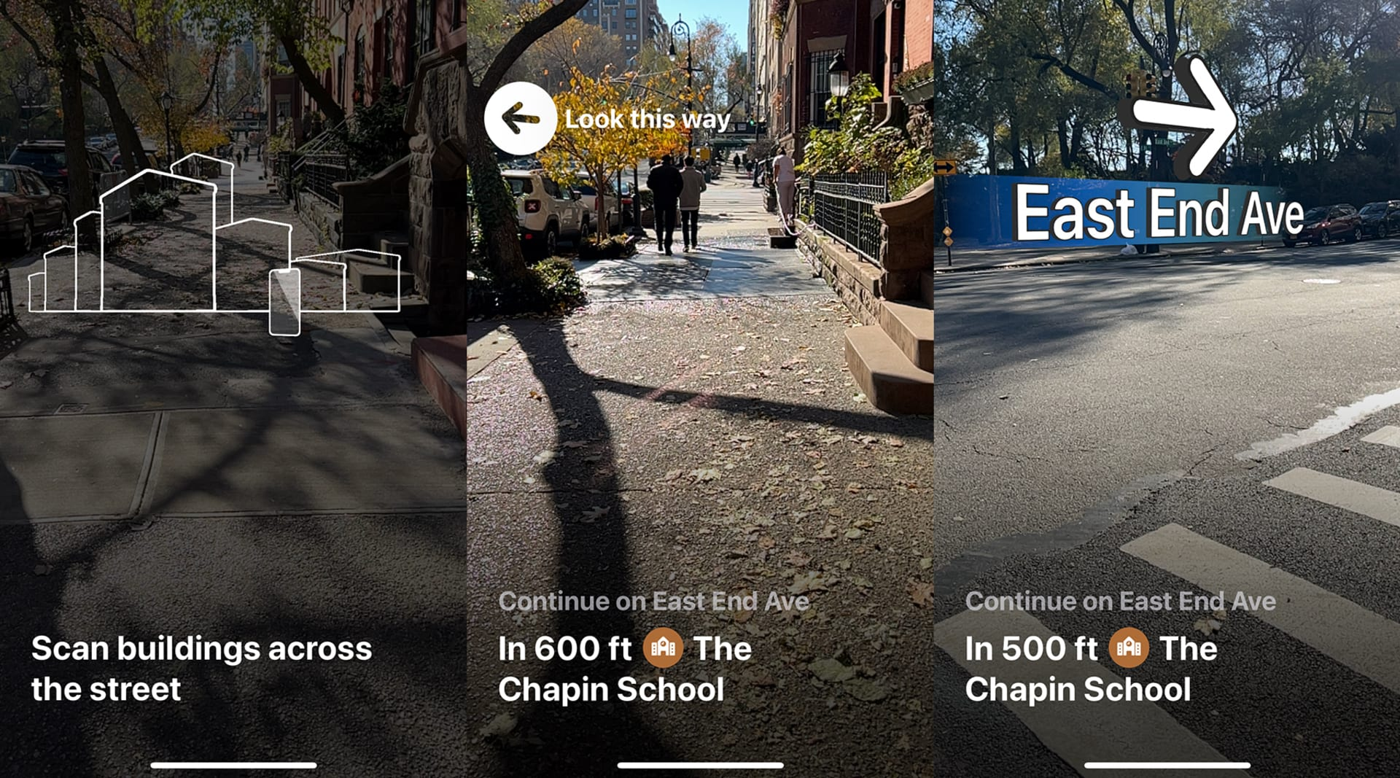
Applications of Computer vision with Augmented reality
Enhanced AI navigation

Slide 4
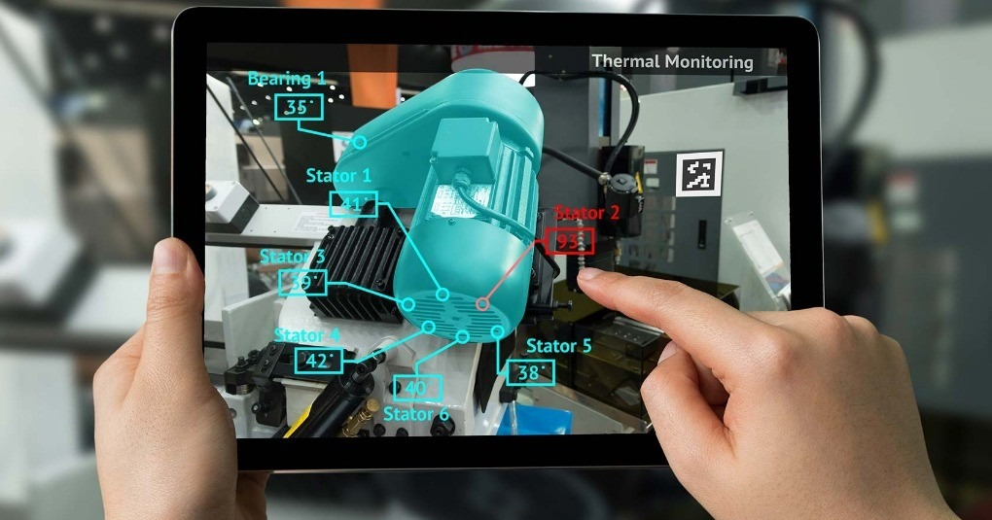
Applications of Computer vision with Augmented reality ctd..
AR powered Remote Assistance

Slide 5

Applications of Computer vision with Augmented reality ctd..
Real-Time Language Translation

Slide 6

2. Edge Computing with Computer Vision
Edge Computer Vision refers to the processing of visual data (images, videos) directly on the edge devices, like cameras or IOT devices, rather than sending the data to remote servers or cloud
Mainly used in the application areas such as
Real-Time Processing
Privacy and security
Reduced Bandwidth and cost
Improved Reliability

Slide 7
References
https://www.geeksforgeeks.org/top-10-computer-vision-trends-to-watch-in-2022/
https://www.forbes.com/sites/bernardmarr/2023/09/26/from-healthcare-to-space-top-10-transformative-computer-vision-trends-in-2024/

